Slide 1
Short-News
Presented By:
Md. Hasibur Rahman(19101009)
Tanmoy Mazumder(19101013) Shawon Das(19101020)
Presented To:
Mehedi Sir
Lecturer, Dept. CSE
University of Asia Pacific

Slide 2
Project Proposal
01
Problem Definition
02
Impact on Society
TABLE OF CONTENTS
04
Motivation
03
Critical challenges
05
Project Management
06
Introduction
Explanation of the problem
How it will help others
Why we chose this
Roadblocks to overcome
Timelines and Cost

Slide 3
01
Project Proposal

Slide 4

Summarized News Portal
The Idea
Recent news
Summarized
Key points
Save time

Slide 5
The Process
News from other portals
Run them through NLP model
Present on website
Refresh Periodically

Slide 6
02
Problem Definition

Slide 7
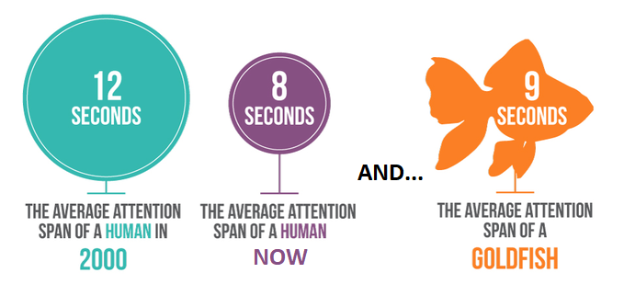
Problem Definition

Slide 8
Problem Breakdown
Time
Not enough time to read much in detail
Problem
Time and attention is scarce, but there’s a silver lining
Attention
80/20
Short Attention span not ideal for long articles
Not all details are equally important

Slide 9
Problem Breakdown
Time
Not enough time to read much in detail
Problem
Time and attention is scarce, but there’s a silver lining
Attention
80/20
Short Attention span not ideal for long articles
Not all details are equally important

Slide 10
Problem Breakdown
Time
Not enough time to read much in detail
Problem
Time and attention is scarce, but there’s a silver lining
Attention
80/20
Short Attention span not ideal for long articles
Not all details are equally important

Slide 11
Problem Breakdown
Time
Not enough time to read much in detail
Problem
Time and attention is scarce, but there’s a silver lining
Attention
80/20
Short Attention span not ideal for long articles
Not all details are equally important

Slide 12
03
Motivation

Slide 13
Core Parts of News
What/Who
Where
When
Info of the Main News
Location
Time of the event

Slide 14
Sources of the Idea
Existing Similar Sites
NLP
Fulfils Requirements
Summarization is a prominent sub-field of Natural Language Processing
Morning Brew
Today Brief
The skimm
Complex Engineering problem
Involves Web programming
Requires Database Management

Slide 15
04
Impact on Society

Slide 16

Impact on Society
Save Time
Promoting news reading
Can Use anytime
Awareness
Proper information
No cost
No Legal Issue

Slide 17
05
Critical Challenges

Slide 18

Critical Challenges
User connectivity
Model Design
News
Need resource
Legal Issue

Slide 19
06
Project Management & Cost analysis

Slide 20
Project Management
Purpose | Duration
Project Selection | 3rd Week
Project Proposal | 4th Week
UML Design | 5th Week
Project Update | 6th - 11th Week
Develop & Testing | 12th - 13th Week
Final Presentation & Report Writing | 14th Week

Slide 21
Cost Analysis
 |  |  | Year 0 | Year 1 | Year 2 | Year 3 | Year 4 | Total
Benifit |  | Advertisement | 0 | 75,000 | 120,000 | 150,700 | 200,000 | 545,700
 |  | Total Benefit | 0 | 75,000 | 120,000 | 150,700 | 200,000 | 545,700
COST | Development Costs | Site Development & Publishing | 20,000 | 0 | 0 | 0 | 0 | 20,000
 |  | Server Hosting | 0 | 10,000 | 10,000 | 10,000 | 10,000 | 40,000
 |  | Maintenance Cost | 0 | 15,000 | 15,000 | 15,000 | 15,000 | 60,000
 |  | Total Development cost | 20,000 | 25,000 | 25,000 | 25,000 | 25,000 | 120,000
 | Operational Costs | Advertisement | 0 | 60,000 | 50,000 | 50,000 | 40,000 | 200,000
 |  | Management | 0 | 30,000 | 40,000 | 50,000 | 50,000 | 170,000
 |  | Total Operational Cost | 0 | 90,000 | 90,000 | 100,000 | 90,000 | 370,000
 | Total Costs |  | 20,000 | 115,000 | 115,000 | 125,000 | 115,000 | 490,000
Net Benefits = Total benefits - Total cost |  |  | [20,000] | [40,000] | 5,000 | 25,700 | 85,000 | 55,700
Cumulative Net Cash Flow |  |  | [20,000] | [60,000] | [55,000] | [29,300] | 55,700
Return on Investment (ROI) |  |  | 11.36% (55,700 / 490,000)*100%
Break-even Point (BEP) |  |  | 2.3 years [2 years + (85,000 - 55,700) / 85,000]

Slide 22
THANK YOU
Any Questions?

